Slide 1
(A night out at the SU)
SU-rvival
Created by Team 13

Slide 2
What is SU-rvival?
Our game gives you the chance to experience a typical night out at the SU through a text based adventure game.
“Experience life on the clubbing scene with SU-rvival. Can you survive until the end of the night? Complete a round of ring of fire, have a ride in a taxi and party the night away! But careful… you need enough money to get a ride back, you are just a sip away from passing out and not all as it seems…”

Slide 3
Justification of design decisions
In the initial meetings we decided on the theme/story of the game and all the elements that would be included. We justified every idea we had to make sure it would benefit the game
Theme was decided as an encouragement for all ages (teen and above) to play text based, retro style games
Having lots of elements to the game, eg ring of fire, makes the game stand out from others
Player characteristics gives each game the opportunity to be unique to the player, as well as the random events that happen throughout the game
Notes:
Theme – whether uni students (play to relive last Saturday night, without fear of hangover), or adults to reminisce about their past experiences, or to see if anything has changed
Elements – Ring of fire like a mini-game,
Characteristics – Having their name, gender, smoking status chosen at the start. Random events also make every game unique

Slide 4
Details of implementations
Using the base template of an adventure game, editing the code to create our base game
Extra code written around base code to enhance and add to the basic game to make it more advance and distinctive to our game
Created lots of files for the different aspects of code eg game.py, items.py

Slide 5
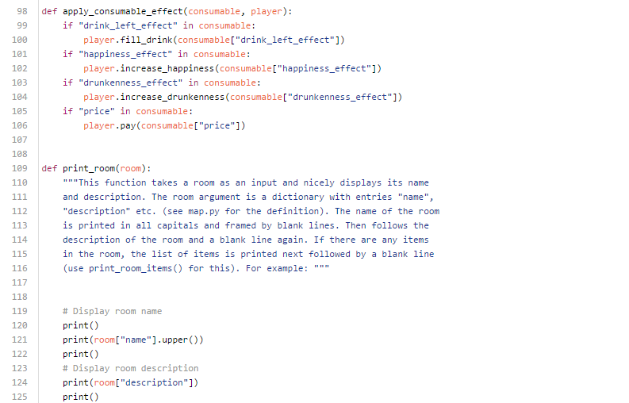
Examples of code
Example in our game.py of various functions from game template and written code

Slide 6
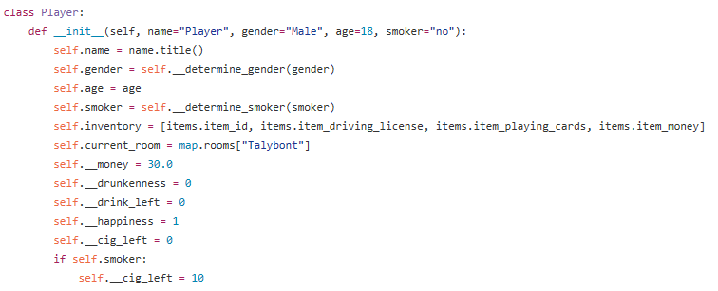
Examples of code
In our game our player has a number of properties such as drunkenness and happiness. We decided to encapsulate these into a player class. This makes coding easier as we don’t have to worry about the detailed workings of the player. Here is an example of our code:

Slide 7
Problems we have encountered
During the process of creating our game we encountered many obstacles that we had to overcome:
Not everyone in our team can code.
Those who can have different coding styles.
People who couldn’t code felt like they weren’t helping with the project as much.
Nobody knows Git so nobody used it properly, this meant that people would overwrite other peoples changes.

Slide 8
How we worked as a team
We worked very well as a team…
We attended team meetings where we discussed what needed to be done, who was doing what and time management.
We created a group chat where we discussed any problems and asked questions when unsure of anything. This is where we also sent images of what had been done so far so that we could all agree and come to a conclusion.
We also created a group on GitHub where we uploaded all of the files that we had created.
We used GitHub Wiki to create 4 pages, here's one of our pages:

Slide 9
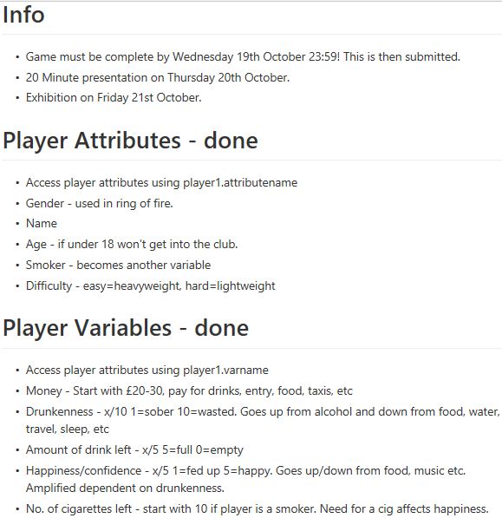
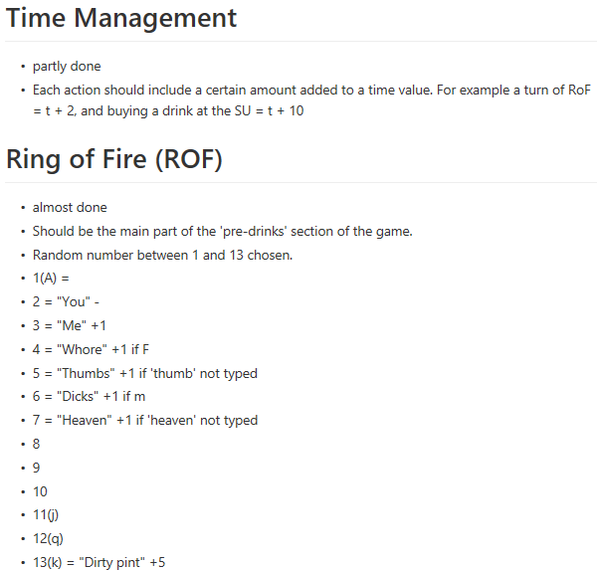
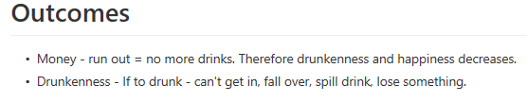

Slide 10
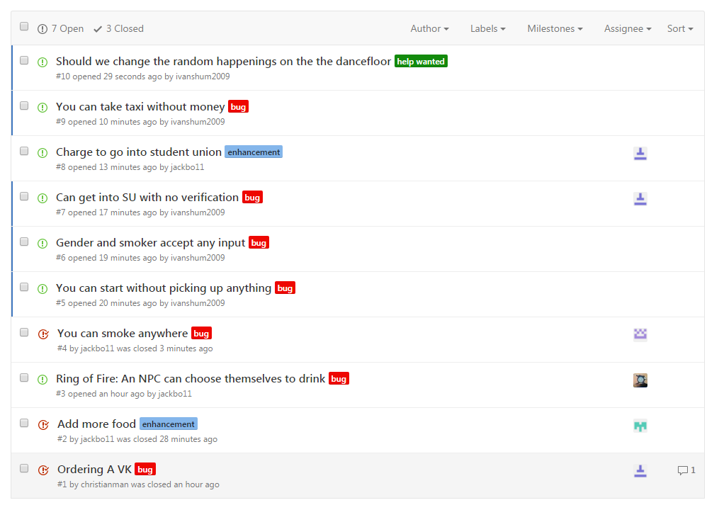
Notes:
Bug testing, everybody tested the game and submitted bugs on github, we then attempted to fix said bugs

Slide 11
Distribution of workload
Each team member was given individual tasks depending on their ability so that everybody played a role within the project. This also meant that the people with no coding experience could still participate.
Ring of fire - Will
Items, inventory etc - Christian + Ali
Resident genius - Jack
Presentation - Rebecca and Ellie
Poster – Rex
Map, test the game - Ivan

Slide 12
Interesting Features
We added interesting features to our game in hope that we would attract more people and make text based adventure games more fun!!
We added music to our game so that when the player is in the club you can listen to the songs.
We added ring of fire which is a popular drinking game to make it like a more realistic night out for a student.

Slide 13
Why purchase our game?
We believe that our game will attract many students due to being based on a night out at the SU.
Our game has interesting features, one being that it can play music.
You can play games within our game such as ring of fire.

Slide 14
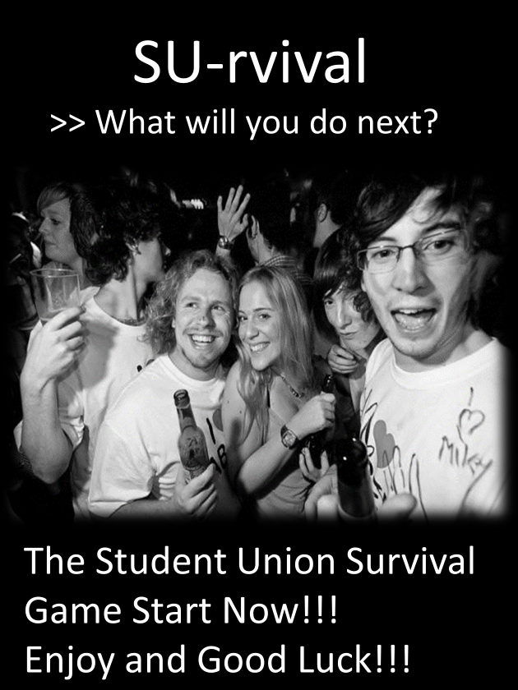

Slide 15
And now what you’ve all been waiting for …
Let’s Play!
Git clone https://github.com/jackbo11/cm1101_team13_game.git

